Slide 1

Medical Insurance Cost Prediction
using Regression in IBM SPSS Modeler
A Machine Learning Regression Project
Achyut Kumar Pathak | Mousumi Guin | Arya Singh

Slide 2




Team Members
Achyut Kumar Pathak
Project design, SPSS workflow development, model building, and analysis
Mousumi Guin
Data preparation, node configuration, and dataset interpretation
Arya Singh
Presentation preparation, result explanation, and project documentation
Medical Insurance Cost Prediction | IBM SPSS Modeler

Slide 3

Project Overview
This project predicts medical insurance charges using regression analysis
The model is built using IBM SPSS Modeler — a visual data mining tool
Target variable: "charges" (medical insurance cost)
Goal: Estimate insurance cost based on a person's demographic and health profile
Dataset includes both demographic and health-related variables
Useful for insurance pricing, risk assessment, and cost forecasting
Medical Insurance Cost Prediction | IBM SPSS Modeler

Slide 4
Dataset Used
Medical Insurance Cost Prediction Dataset
Field | Type | Role | Description
age | Continuous | Input | Age of the insured person
sex | Nominal | Input | Gender (male/female)
bmi | Continuous | Input | Body Mass Index
children | Continuous | Input | Number of dependents
smoker | Nominal | Input | Smoking status (yes/no)
region | Nominal | Input | Geographic region
charges | Continuous | Target | Insurance cost (to be predicted)
This is a regression problem because the target is continuous numeric data.
Medical Insurance Cost Prediction | IBM SPSS Modeler

Slide 5

Why Regression is Used
The target variable "charges" contains continuous numeric values (e.g., $1,725 to $63,770)
Regression is the appropriate ML technique when predicting a numerical amount
The model learns the mathematical relationship between input features and charges
Example: A 45-year-old male smoker with BMI 30 → Predicted charge: ~$39,611
Example: A 19-year-old female non-smoker with BMI 28 → Predicted charge: ~$1,837
This helps insurance companies estimate expected cost for any customer profile
Medical Insurance Cost Prediction | IBM SPSS Modeler

Slide 6

SPSS Modeler Stream Overview
Complete Workflow Pipeline
insurance.csv
Type
Partition
Training Branch (80%)
Testing Branch (20%)
Select
Type
Regression
Select
Type
Nugget
Output
Table
Analysis
Dataset is split into 80% training and 20% testing for model validation
Medical Insurance Cost Prediction | IBM SPSS Modeler

Slide 7
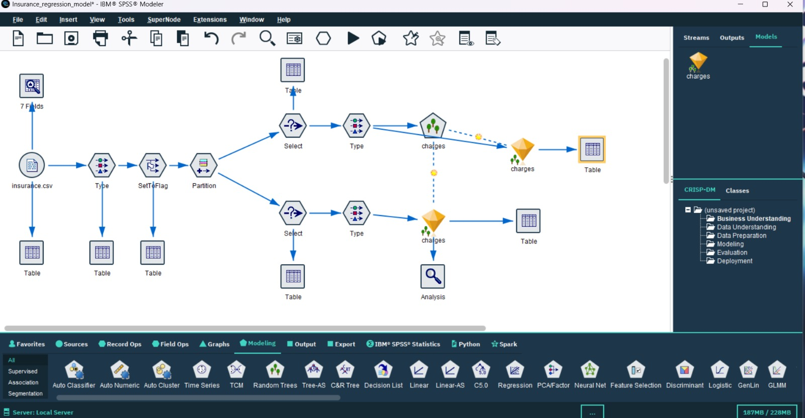
SPSS Modeler Stream
Medical Insurance Cost Prediction | IBM SPSS Modeler

Slide 8



Nodes: Source Node, Data Audit Node &Type Node
Node 1: Source Node (insurance.csv)
Node 2:Data Audit Node
Node 3: Type Node
Defines data types and roles for all columns
age, bmi, children → Continuous / Input
sex, smoker, region → Nominal / Input
charges → Continuous / Target
One of the most critical preprocessing steps
Imports the insurance dataset into SPSS Modeler
Starting point of the entire data stream
Contains all 7 fields from the CSV file
Provides raw data for all downstream processing
No transformations applied at this stage
Provides an overall summary of the dataset
Checks the quality of the data
Identifies missing values, errors, and duplicate records
Medical Insurance Cost Prediction | IBM SPSS Modeler

Slide 9




Nodes: SetToFlag , Partition & Select (Training)
Node 4: SetToFlag Node
Transforms text categories into binary (0/1) numeric values
Helps machine learning models process data effectively
Enhances accuracy and prediction quality
Node 5: Partition Node
Node 6: Select Node (Training)
Splits dataset into training and testing data
80% allocated for training the model
20% reserved for testing/validation
Improves model validation accuracy
Prevents overfitting on training data
Random sampling has been applied for the partition purpose
Filters only the training partition records
Selects the 80% training rows
These records are used to train the regression model
Ensures clean separation of training data
Medical Insurance Cost Prediction | IBM SPSS Modeler

Slide 10

Node 7: Type (Training) & Node 8: Regression Model
Node 7: Type Node (Training Branch)
Node 8: Regression Model Node
Reconfirms field roles in the training branch
Ensures "charges" remains the target
All other variables confirmed as inputs
Prevents modeling errors before training
Core ML node — builds the regression model
Learns: age, sex, bmi, children, smoker, region → charges
Predicts expected insurance charges
Generates trained model (Gold Nugget)
Uses linear regression algorithm
Medical Insurance Cost Prediction | IBM SPSS Modeler

Slide 11
Node 9: Select (Testing) & Node 10: Type (Testing)
Node 9: Select Node (Testing)
Node 10: Type Node (Testing Branch)
Selects only the 20% testing partition records
These rows were NOT used during training
Used exclusively for validation and prediction checking
Ensures unbiased model evaluation
Confirms correct metadata for the testing branch
Ensures consistency with training data structure
Helps the model apply correctly on unseen data
Validates field types match expectations
Medical Insurance Cost Prediction | IBM SPSS Modeler

Slide 12



Node 11: Model Nugget & Node 12: Table Node
Node 11: Model Nugget (Apply Model)
Node 12: Table Node
Applies trained regression model to test data
Creates predicted values for "charges"
Generates new column: $R-charges or $RP-charges
Original charges = actual cost
Predicted charges = model's estimated cost
Displays final output in tabular format
Shows actual vs predicted charges side by side
Helps compare prediction accuracy visually
Key node for result verification
Medical Insurance Cost Prediction | IBM SPSS Modeler

Slide 13


Node 13: Analysis & Understanding Predictions
Node 13: Analysis Node
Understanding Predicted Column
Evaluates regression model performance
Shows error comparison and residual analysis
Measures accuracy of prediction trend
Provides model fit insights
Essential for understanding model quality
Model creates a new predicted field for charges
Uses age, BMI, smoking status etc. for estimation
Actual charges = real insurance amount in dataset
Predicted charges = model's estimated amount
Comparison validates model effectiveness
Medical Insurance Cost Prediction | IBM SPSS Modeler

Slide 14
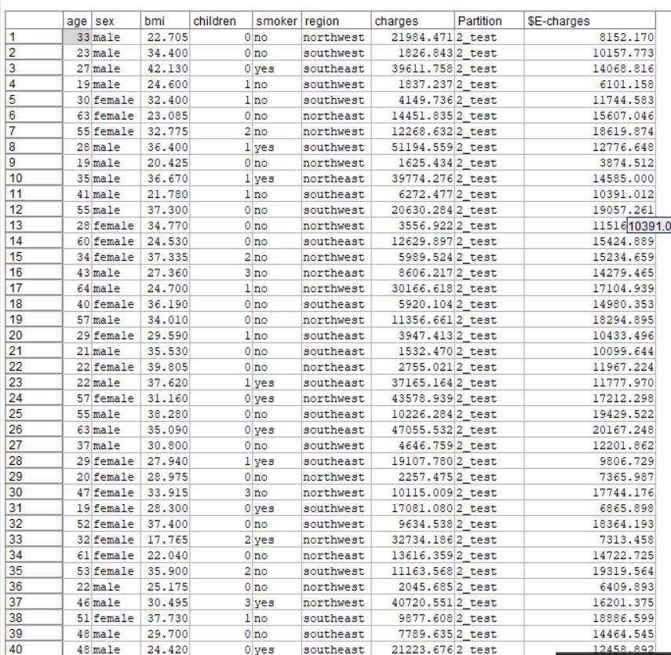
Final Output Result
SPSS Modeler Output: Actual charges vs Predicted charges ($E-charges) with Partition
Medical Insurance Cost Prediction | IBM SPSS Modeler

Slide 15

Key Insights Derived
Smokers Pay More
Smokers generally have significantly higher insurance charges
BMI Impact
Higher BMI increases medical risk and insurance cost
Age Factor
Older age tends to increase insurance charges
Combined Predictors
Categorical and numeric variables together improve prediction quality
Medical Insurance Cost Prediction | IBM SPSS Modeler

Slide 16

Real-World Use of This Model
Insurance companies can estimate expected medical cost for new customers
Helps in pricing insurance policies accurately based on customer risk profile
Supports customer risk analysis and categorization
Aids premium estimation and financial planning decisions
Can be integrated into automated insurance quoting systems
Provides data-driven insights for underwriting processes
Medical Insurance Cost Prediction | IBM SPSS Modeler

Slide 17

Conclusion
Successfully demonstrated regression-based cost prediction in IBM SPSS Modeler
Model trained on 80% data and validated on 20% testing data
SPSS nodes (Type, Partition, Select, Regression, Table, Analysis) used effectively
Model generated predicted insurance charges based on user profile attributes
Regression is the appropriate technique for continuous target prediction
This project is a practical example of ML for real-world cost estimation
Medical Insurance Cost Prediction | IBM SPSS Modeler

Slide 18

Thank You
Medical Insurance Cost Prediction
using Regression in IBM SPSS Modeler
Achyut Kumar Pathak | Mousumi Guin | Arya Singh

